Slide 1


Sanctuary of Bastia in Busalla: Structural Analysis
This presentation explores the structural analysis of the Sanctuary of Bastia in Busalla, Italy, focusing on the second span from the eastern side of the central nave.
Professors
Chiara Calderini, Antonio Caggiano and Giuseppe Riotto
Sina Tarighi, Ebrahim Fatahi, Bijan Ehsani

Slide 2


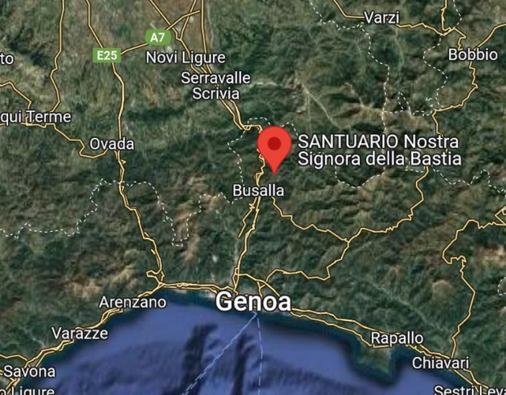
Historical Context
Architectural Significance
Location
The Sanctuary of Bastia is an architectural and cultural landmark, showcasing traditional religious architecture with vaulted ceilings, intricate wooden roofing, and masonry arches.
Nestled in the picturesque town of Busalla, the sanctuary is surrounded by the serene beauty of the Ligurian landscape, offering a glimpse into the architectural traditions of the region.

Slide 3
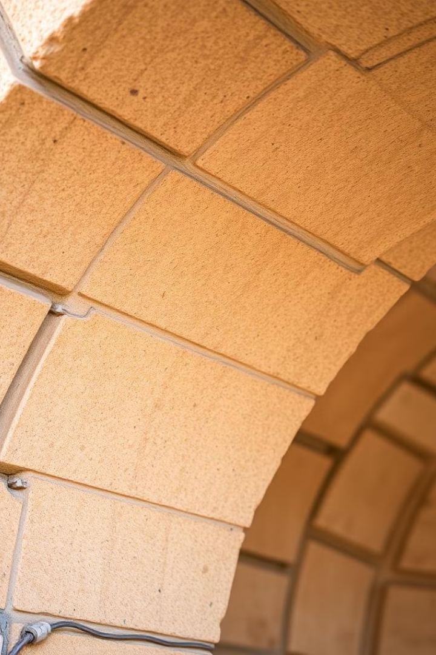
Engineering Challenges and Restoration
1
Roofing Structure and Central Barrel Vault
The original structure exhibited excessive deformations, particularly in the barrel vault. The restoration involved dismantling and replacing the vault while retaining the load-bearing arches.
2
Consolidation Techniques
The project utilized innovative methods such as the "stitch and unstitch" technique to reinforce masonry and applied natural hydraulic lime and fiber-reinforced composite materials (FCRM) to enhance structural integrity.

Slide 4
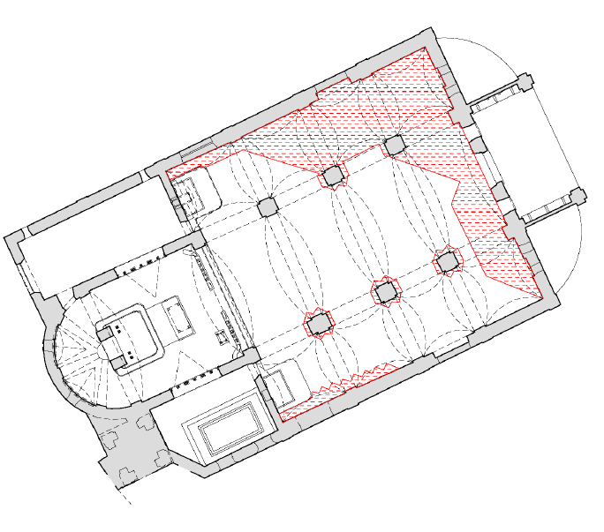

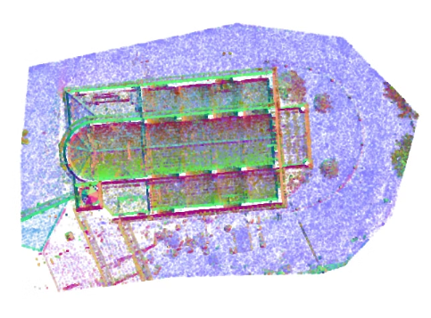
Project Scope and Methodology
Target Area
Modeling
Computational Analysis
This workshop project entailed an in-depth investigation of the second span from the eastern side, encompassing four sail vaults and three arches.
The analysis commenced with the creation of a precise three-dimensional geometric model in AutoCAD, accurately capturing the structural features and dimensions.
This model was subsequently imported into ANSYS for advanced computational analysis, focusing on evaluating the static forces acting on the roof.

Slide 5
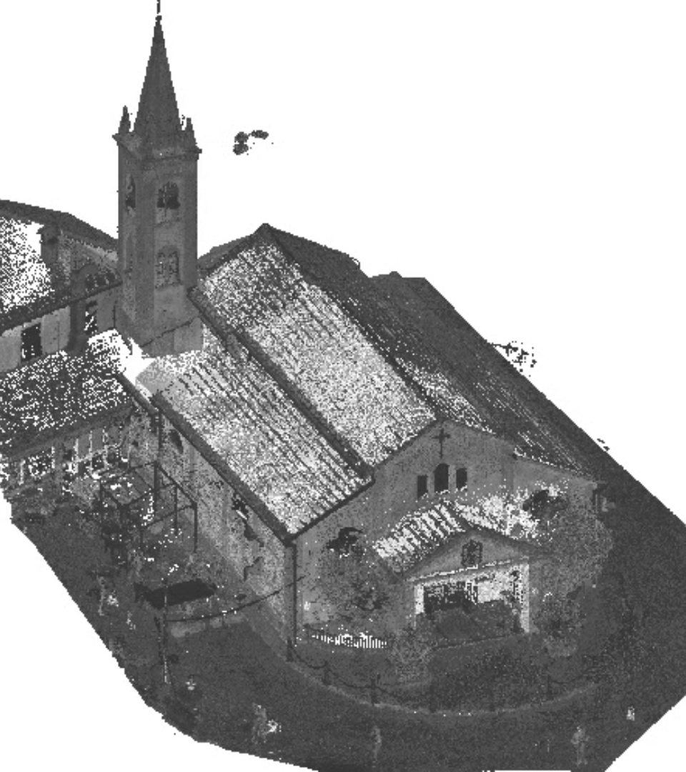
Survey
Laser-scanner survey
Dimensions
Key Features
The project focused on the second span, spanning 13.5 meters.
It featured four sail vaults and three arches.
The model facilitated detailed computational analysis to assess structural behavior.

Slide 6
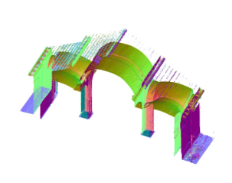
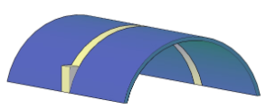
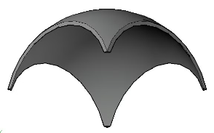
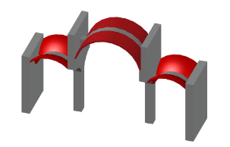
AutoCAD 3D Modeling
1
Units and Point Cloud
The file was set to the SI system and meters using the _Units command. The provided Point Cloud file was attached in AutoCAD and rotated by 16 degrees.
2
UCS for Plan and Vertical View
UCS was defined for the plan and vertical view to draw the walls, arches, and vaults accurately.
3
Designing Arches and Vaults
The arches and vaults were designed using the Subtract command with elliptical geometry, ensuring accurate representation of the actual structure.
4
Refining Geometry and Grouping
The finalized geometry was refined to eliminate imperfections and grouped based on material types for analysis in Ansys.

Slide 7
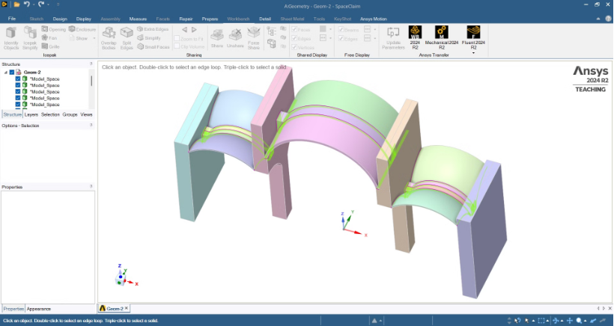
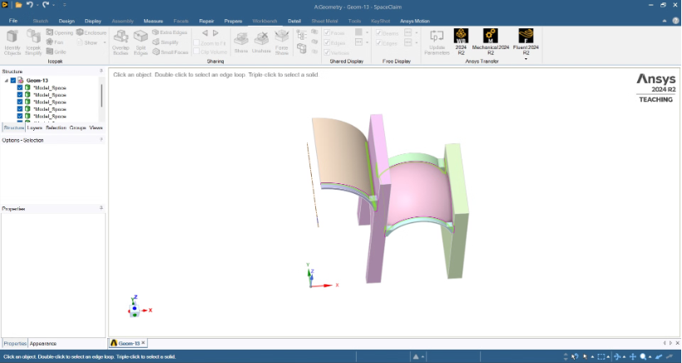
Refining Geometry for Mesh Optimization
Refining Geometry for Mesh Optimization To ensure smooth meshing in Ansys, sharp edges in arches and vaults were smoothed using the Slice command. Overlaps at connections (vaults, arches, walls) were corrected, and further simplifications/errors were addressed in Ansys SpaceClaim.

Slide 8
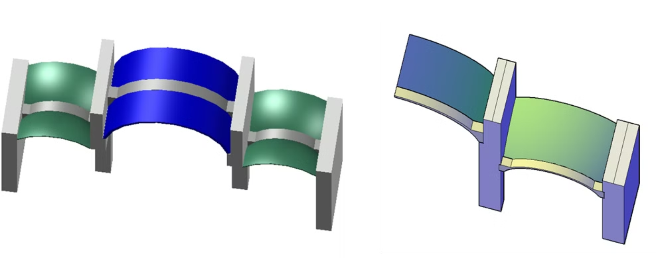

Slide 9
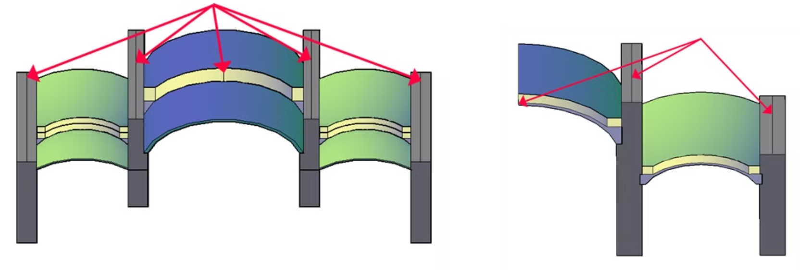
Load Application & Final Preparation
Distributed & Concentrated Load: A centerline was created along walls and arches between barrel vaults to define the distributed load application in Ansys.
W-Block Export: All necessary elements were selected, and the geometry was saved using the W-Block command for import into Ansys Workbench.

Slide 10


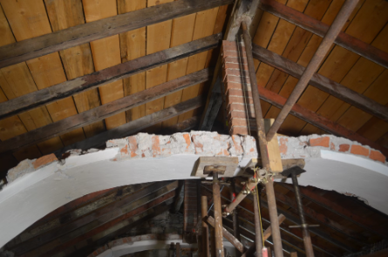
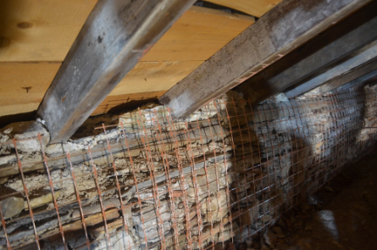
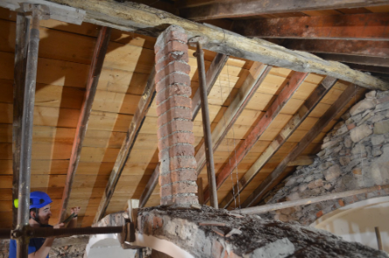
Static Analysis
Material Properties
Load Analysis
The material specifications of the roof, including wooden raft, wooden sheet, and Marseille tile, were used to determine the amount of static load applied.
The static load applied to the lateral walls and the central span vault was determined using the Ftools software, considering the weight of each component.

Slide 11
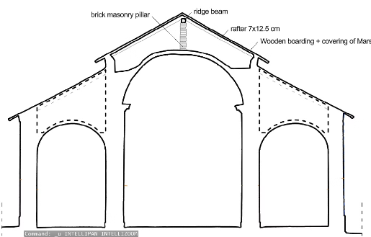
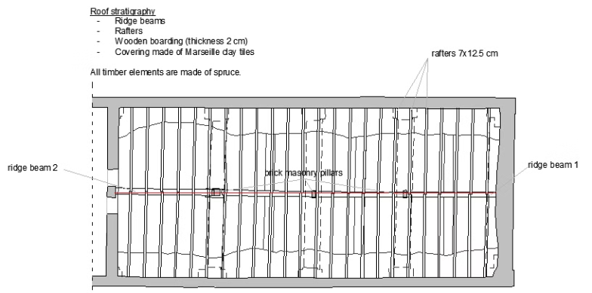
Static Analysis
The material specifications of the roof:
1
Wooden raft
2
Wooden sheet
3
Marseille tile

Slide 12
Material properties
Material properties
Elements
ɣ
Units
Wooden raft
4.5
KN/m3
Wooden sheet
4.5
KN/m3
Marseille tile
44
KN
ɣ
Units
Height
Width
Length
Numbers
Roof Length
Wooden raft
4.5
KN/m3
0.125
0.07
4
18
9
Wooden sheet
4.5
KN/m3
0.02
-
4
-
9
Marseille tile
44
KN
-
-
-
-
-
Number per m2
Each block
Weight
Unit
Marseille tile
13
3.4
44.2
KN

Slide 13
Length of Main Timber
9
m
Timber span
0.5
m
θ
30
Degree
W1
0.079
KN/m2
W2
0.09
KN/m2
W3
0.450560652
KN/m2
W total
0.62
KN/m2

Slide 14
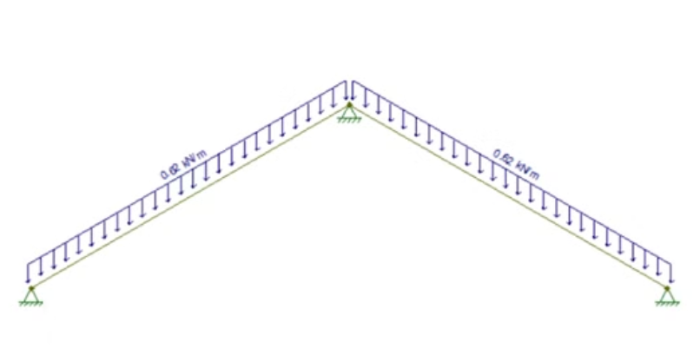
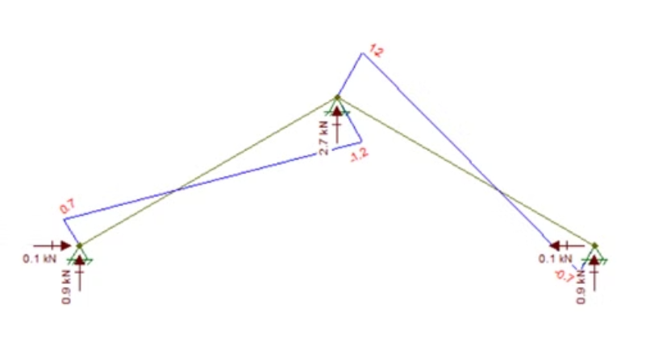
Ftool Results

Slide 15
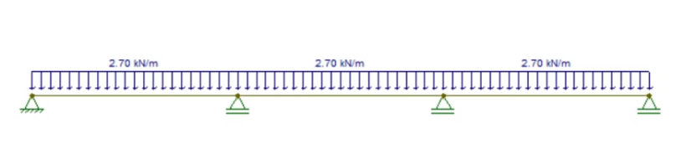
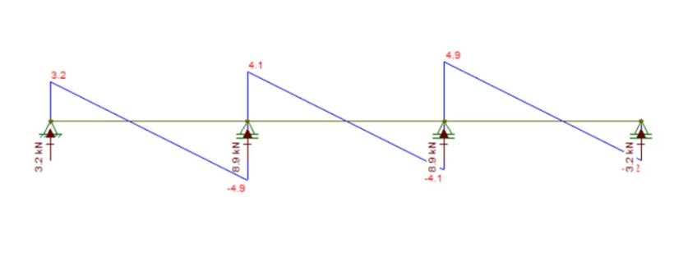
Ftool Results

Slide 16
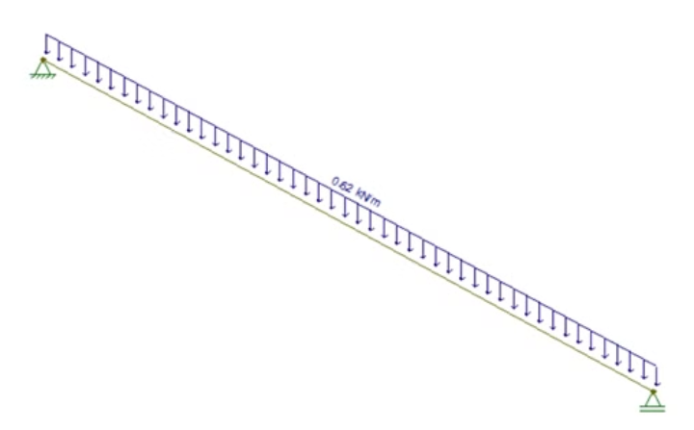
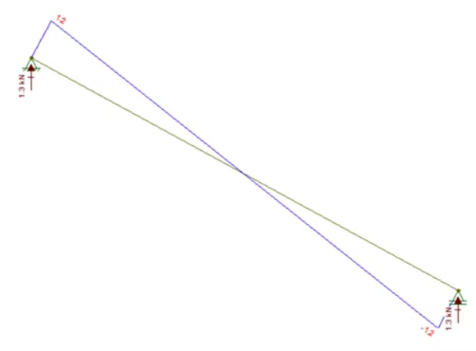
Ftool Results

Slide 17
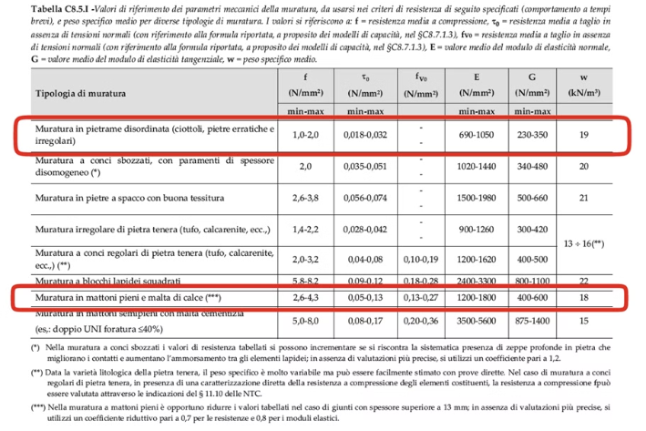
Material Modeling & Assumptions
Nonlinear Behavior: The Drucker-Prager Concrete model is used for both stone/brick masonry and infill.
Material Properties: Based on Italian Circolare 7/2019 (Table C8.5.I):
Young’s modulus E → Average of the proposed range.
Uniaxial compressive strength fc → Minimum of the proposed range.
Confidence factor (1.35) applied to compressive strength due to LC1 knowledge level.
Biaxial compressive strength (fbc) calculated as 1.5 × fc (from literature).
Adjustment for Masonry with Thick Joints
For solid brick masonry with lime mortar, if joint thickness exceeds 13 mm:
Resistance values → Reduced by 0.7.
Elastic modulus (E) → Reduced by 0.8.
If no precise evaluations are available, these reduction factors must be applied.

Slide 18
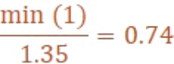
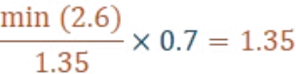
Load analysis
f (MPa)
E (MPa)
ν
ft (MPa)
Walls and Pillars
1 – 2
690 – 1050
0.2
0.05
↓
↓
Average = 870
Arches and Vaults
2.6 – 4.3
1200 – 1800
0.2
0.05
↓
↓
Average (1500) × 0.8 = 1200

Slide 19





Ansys Analysis
Engineering Input Data
The material properties of the walls, pillars, vaults, and arches were defined in Ansys, considering the combination loads and amplification factors.
Geometery Assignment and Refinment
Refining the geometery and assign the material to the geometery
Meshing
The geometry was meshed using a combination of methods, ensuring adequate element quality and aspect ratio for accurate results.
Static Structural Analysis and Result
The static structural analysis was performed in Ansys, considering boundary conditions, loads, and supports to evaluate the structural behavior under applied forces.

Slide 20
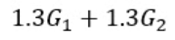
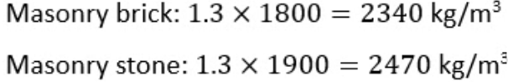
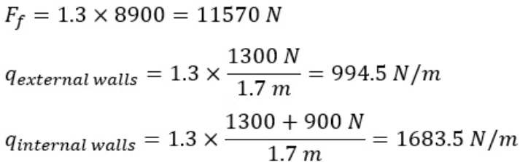
Loads Combination
G1 = structural permeant loads (walls, vaults, arches)
G2= non-structural permeant loads (roof loads)
We took the amplification factor into account by increasing the density of the structural elements by 30% and increasing the roof loads applied on the lateral walls by 30%
The new densities:
Roof loads components:

Slide 21
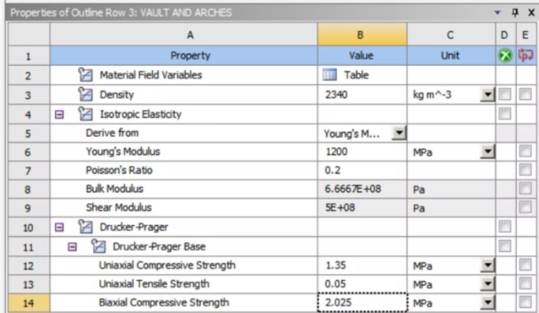
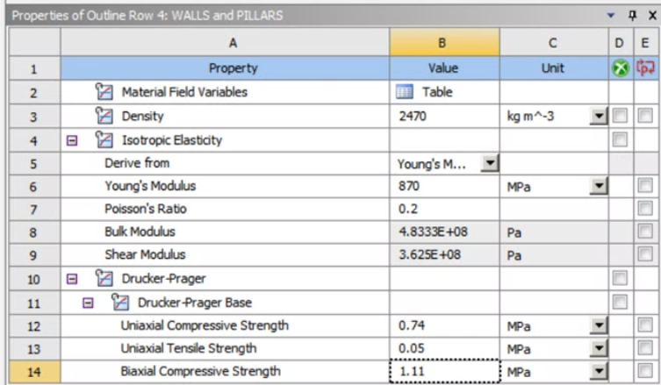
Ansys Analysis (Vertical loads)
Engineering Input Data:
Walls and Pillars
Vaults and Arches

Slide 22
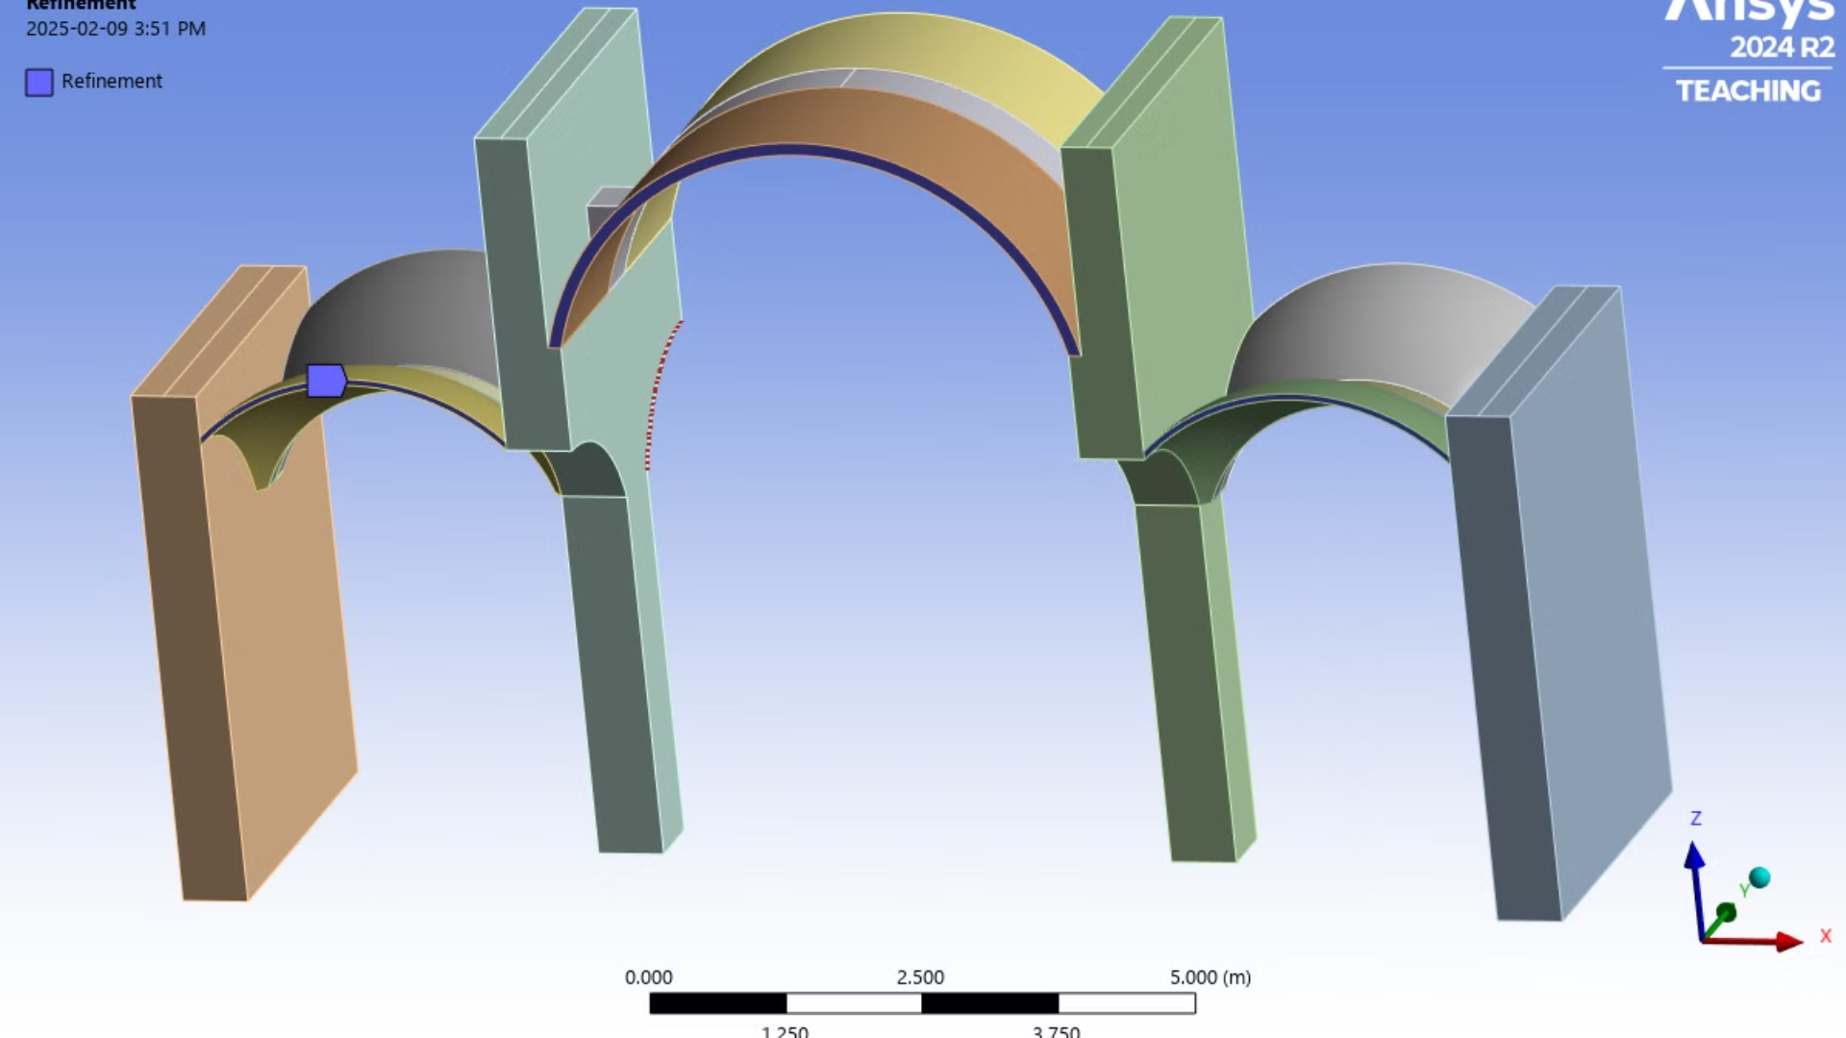
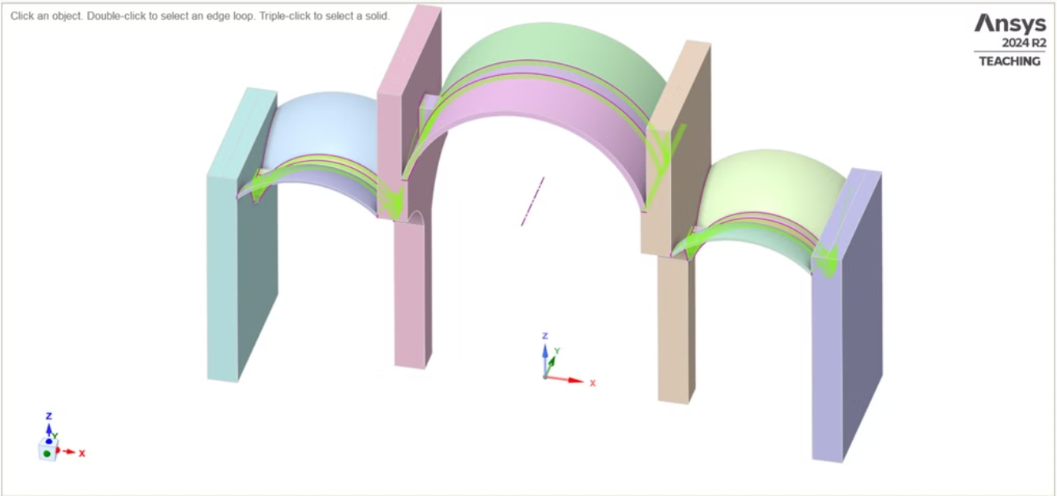
Geometry Definition in Ansys
Refining Geometry and Sharing in Space Claim
Sharing models within SpaceClaim ensures consistency in the simulation process, allowing project to refine CAD data, repair issues, and optimize geometries for meshing and computational efficiency. This enhances the accuracy and performance of structural simulations.

Slide 23
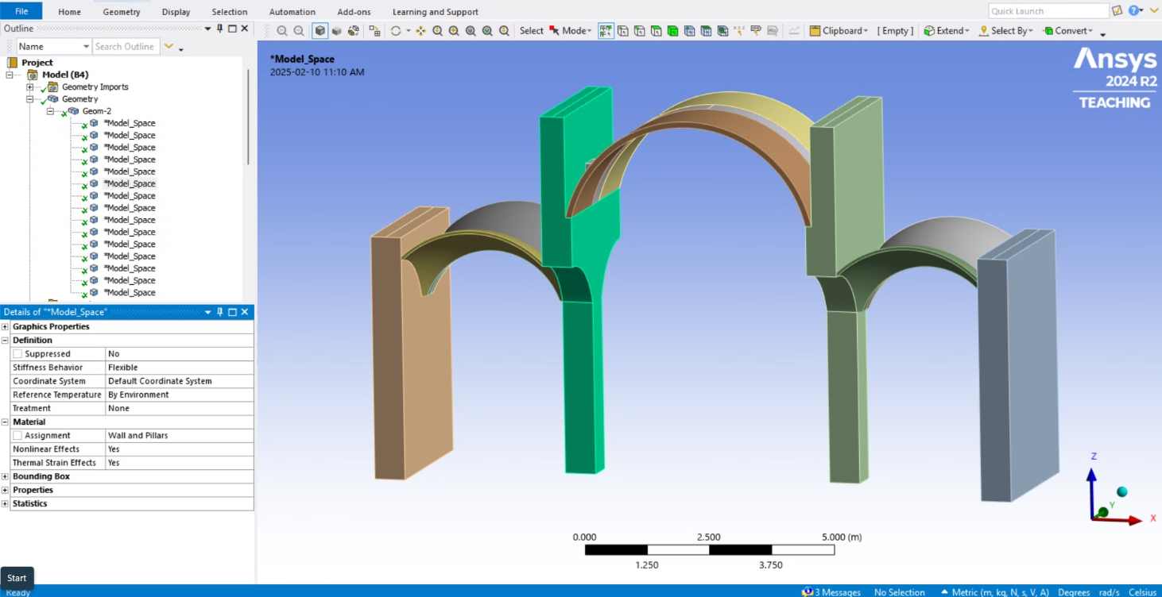
Geometery Properties Assignment

Slide 24
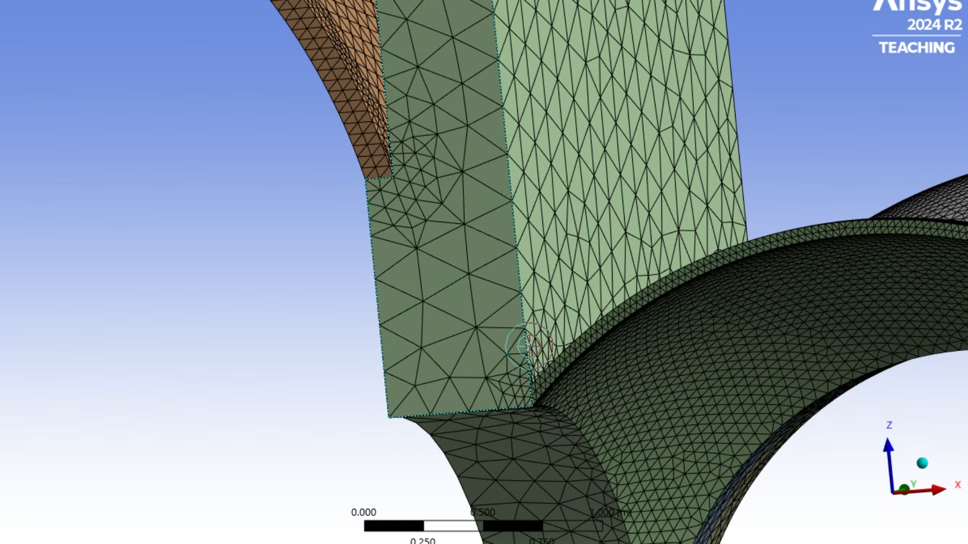
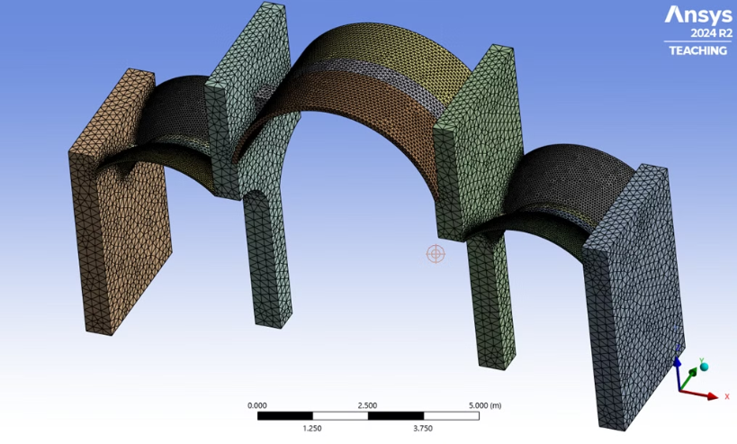
Meshing
Meshing Strategy
Element Models: Structure divided into three parts:
Sail vault
Arches & barrel vault
Walls
Mesh Refinement:
Sail vault: Fine mesh (6 cm) for accuracy due to thinness.
Arches & barrel vault: Medium mesh (10 cm).
Walls: Coarse mesh (20 cm) for efficiency.
Optimization Process: Started with a coarse mesh, refined iteratively until result differences were <5%.
Sail Vault Exception: Using at least three elements per dimension was not accessible, due to large amount of elements and as it did not impact results significantly.

Slide 25
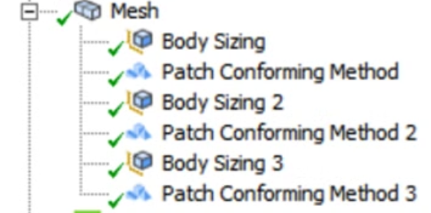
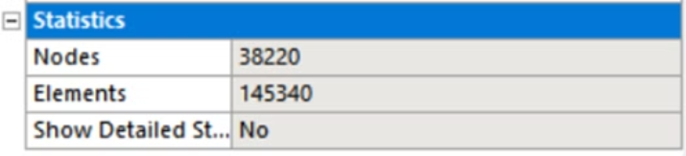
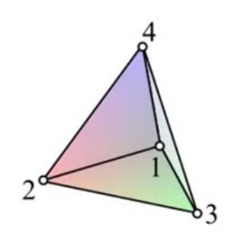
Mesh Sizing and Method
Mesh Statics
A separate meshing method was assigned to each distinct set of elements. In this process, the linear tetrahedron method was utilized.
Considering the constraints imposed in the software, the optimal number of elements and nodes is defined as follows:

Slide 26
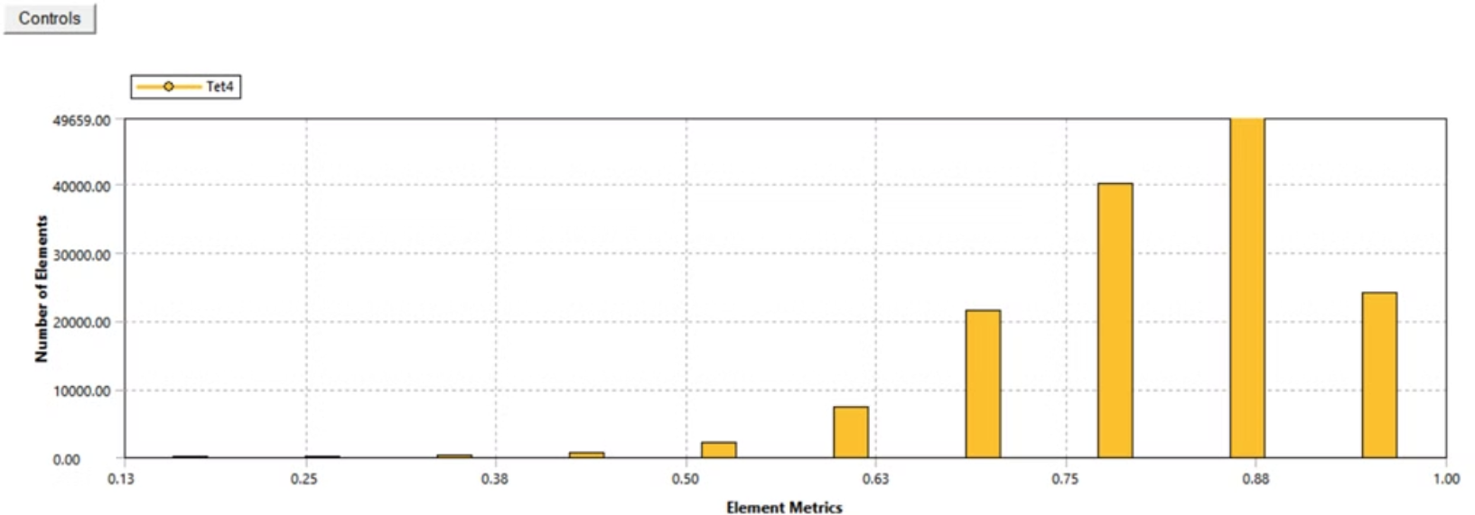
Element Quality of Meshing
High-Quality Elements (0.75–1.0): Majority of the mesh is well-structured, ensuring accurate simulation results.
Low-Quality Elements (<0.5): Few elements may cause minor numerical errors or convergence issues.
Refinement Strategy: If low-quality elements are in critical areas, further refinement can improve accuracy.
Conclusion: The mesh is suitable for analysis with no major issues.

Slide 27
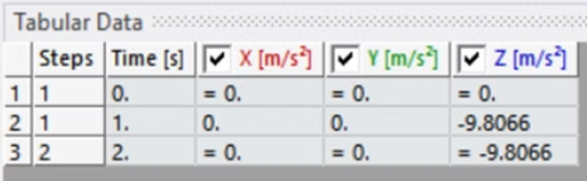
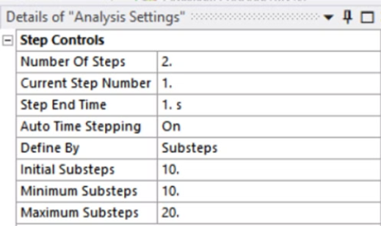
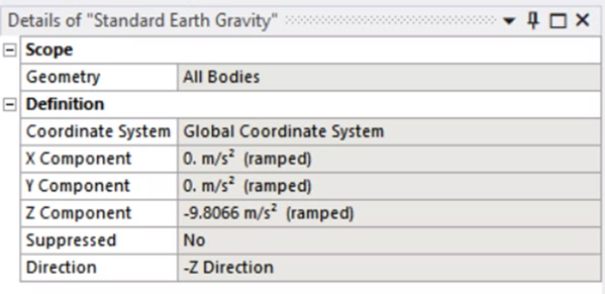
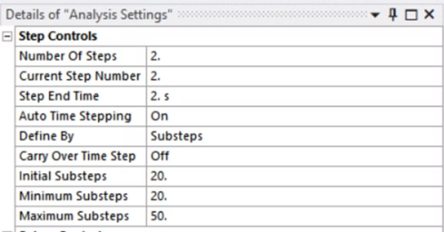
Static Structural
Analysis settings (Steps)
Standard Earth Gravity
In this part, we utilize a two-step process for our calculations. The first step consists of 10 sub-steps, while the second step involves 20 sub-steps.
We assume Gravity Force in Z direction in the both two Steps

Slide 28
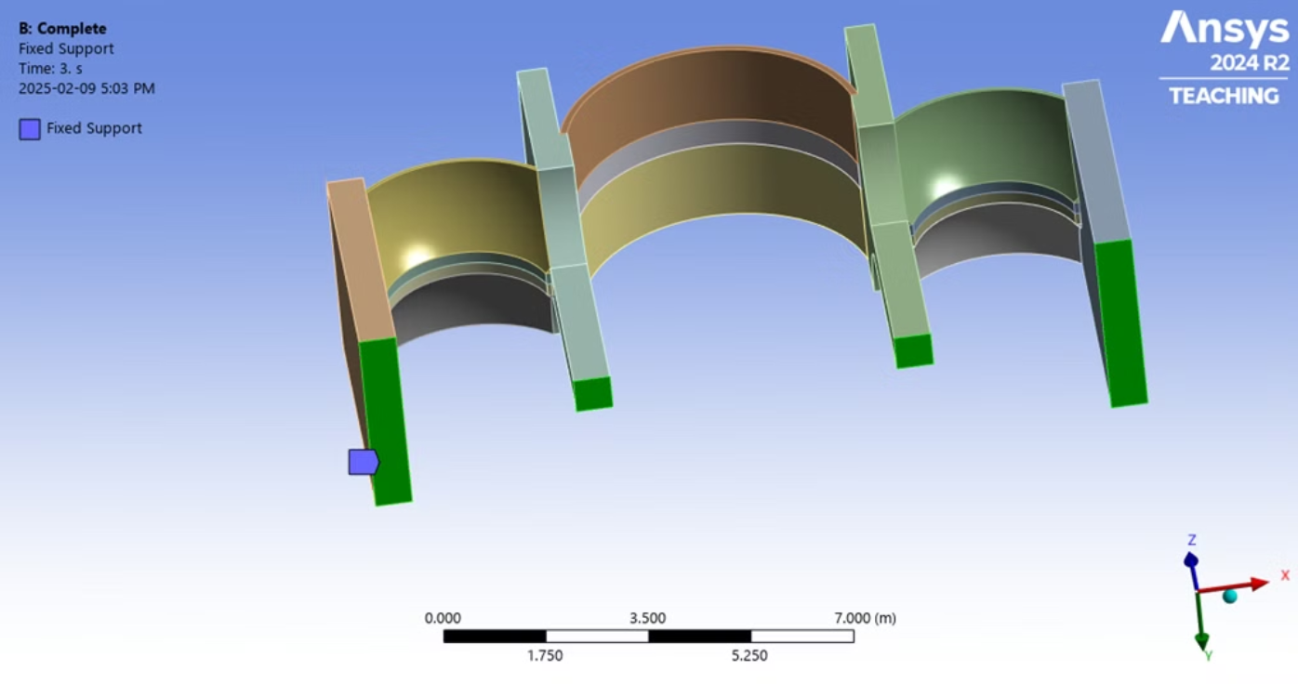
Boundary Conditions
Supports
We assume the connection between walls and ground as a fixed support.

Slide 29
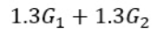
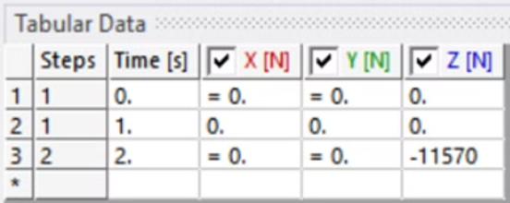
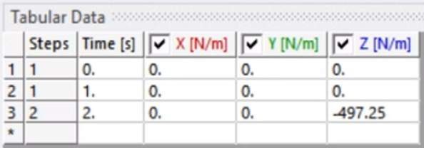
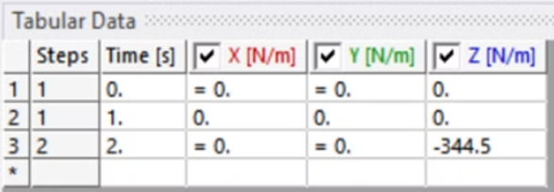

Loads
G1 = structural permeant loads (walls, vaults, arches)
G2= non-structural permeant loads (roof loads)
We took the amplification factor into account by increasing the density of the structural elements by 30% and increasing the roof loads applied on the lateral walls by 30%
At the middle of the barrel vault, we have a concentrated load calculated based on the roof static loads which is equal to 8900 N. Also we calculate the distributed loads on each wall equal to the calculation mentioned bellow:

Slide 30

Each of these loads apply to the structure in the second step.

Slide 31


Displacement
Y-Axis Constraint: Deformation is restricted along the Y-axis due to the structure’s extension in this direction.
X & Z Axes: Movement is unconstrained, allowing free displacement in these directions.

Slide 32

Results
Total deformation
Max Deformation: 0.027459 m at the central curved section (highlighted in red).
Minimal Displacement: Observed in fixed/support regions (blue areas).
Load Distribution: The structure gradually deforms from supports to the middle, effectively distributing gravitational forces.
Maximum deformation = 2.75 cm

Slide 33

Directional Deformati
Directional deformation = 2.68 cmon

Slide 34


Principal Elastic Strain
Maximum Principal Elastic Strain = 0.0005 < 0.00085
Minimum Principal Elastic Strain = 0.000148 < 0.00085
ANSYS Results – Principal Elastic Strains
Tensile Strain (Max): 0.00050051, showing significant variation across the structure.
Compressive Strain (Min): 1.4753e-5, lower and more uniform.
Structural Impact: Higher tensile forces indicate potential areas of concern for structural integrity.

Slide 35


Maximum Principal Stress = 329220 Pa
Minimum Principal Stress = 1125500 Pa
ANSYS Results – Principal Stresses
Tensile Stress (Max): 3.2922 × 10⁵ Pa, more evenly distributed.
Compressive Stress (Min): 1.1255 × 10⁶ Pa, with extreme values in certain areas.
Structural Impact:
Both tensile and compressive forces affect the structure.
Compressive stresses pose a higher risk in specific regions.
Findings help identify potential failure points and ensure structural integrity.

Slide 36


Plastic hinges
EPPL1
EPPL3

Slide 37
Plastic Strain Analysis (EPPL1 vs. EPPL3)
EPPL1:
Max Value: 0.0075
Distribution: Wide variation, gradually decreasing from peak values.
Interpretation: Indicates significant and varied plastic strain across the structure.
EPPL3:
Max Value: 0.00128
Distribution: More uniform and minimal variation.
Interpretation: Suggests consistent and low plastic strain across the structure.
Comparison & Structural Insight
EPPL1 shows higher strain variations, highlighting regions of pronounced deformation.
EPPL3 remains low and uniform, indicating stable areas with minimal strain.
These findings help identify critical regions that may require structural reinforcement.

Slide 38


Ansys Analysis (Horizontal loads)
Engineering Input Data
Walls and Pillars
Vaults and Arches
Based on our load combination, we put the real material density in Engineering Data.

Slide 39


Loads Combination
E = Seismic loads

Slide 40

Meshing

Slide 41


Mesh Sizing and Method and Statics
Element Quality of Meshing

Slide 42



Mesh Refinement
Analysis settings (Steps)
Mesh Refinement for Horizontal Forces (Earthquake)
Refinement Strategy: A refinement of 1 was applied to the edges of specific faces to improve accuracy under horizontal forces (earthquake conditions).
Element Increase: This refinement resulted in 27% more elements, enhancing result precision.
Impact: While it improves accuracy, the refinement also leads to longer analysis time.

Slide 43

Horizontal load
We initially applied an acceleration of 0.3g but encountered a convergence error. To resolve this, we reduced the acceleration until we reached a converged solution at 0.875 m/s².

Slide 44

Results
Total deformation
The maximum total deformation observed is 1.3682 meters. This indicates that the structure experiences significant deformation under the applied forces.

Slide 45

Principal Elastic Strain
Maximum Principal Strain= 0.00051

Slide 46

Minimum Principal Strain= 0.0000119

Slide 47
Strain Analysis Results
Tensile Strain (Max): 0.0005102 mm, significantly higher than compressive strain.
Compressive Strain (Min): 0.0001 mm, lower but still present.
Interpretation:
Tensile deformation dominates, suggesting potential stress concentrations in certain areas.
The presence of compressive strain highlights the need to monitor stability and failure risks.
Conclusion: Ensure that material limits are not exceeded to maintain structural integrity.

Slide 48

Principal Stress
Maximum Principal Stress= 246560 Pa

Slide 49

Minimum Principal Stress= 2884700 Pa

Slide 50
Stress Analysis Results
Compressive Stress (Max): 2.8847 × 10⁶ Pa, significantly higher than tensile stress.
Tensile Stress (Max): 2.4656 × 10⁵ Pa, relatively lower.
Interpretation:
Compressive forces dominate, potentially approaching the material’s compressive strength limit in certain regions.
Tensile stresses are present but not as significant.
Conclusion: The structure must be able to withstand high compressive loads to prevent failure.

Slide 51

Plastic hinges
EPPL 1

Slide 52

EPPL 3

Slide 53
EPPL1 vs. EPPL3 Analysis
EPPL1:
Provides a snapshot at 0.47 seconds but lacks sufficient data for in-depth interpretation.
EPPL3:
Exhibits a comprehensive distribution with values ranging from 0.07906 to -0.10811.
Highlights significant variations, suggesting complex structural behavior.
Conclusion:
EPPL3 identifies critical areas of interest or potential concerns.
More detailed data for EPPL1 would improve the analysis.
Emphasizes the importance of refined simulations for capturing the structure’s full response.

Slide 54

Push-Over Curve

Slide 55

Symmetry Procedure
The other procedure that we have tried was the symmetery analysis of one forth of structure.

Slide 56


Interventions
Barrel Vault and Arches:
Sail Vaults:
FRP, vault consolidation solutions and tie-rods
FRP
Walls and Pillars:
Reinforced conceret for walls and hooping steal for pillars, also we can use tie-rod to prevent out of plane response of the walls

Slide 57
Thank you

